Slide 1
Highways and words: Does isolation predict cultural homogeneity and distinctiveness?
Anjali Bhatt & Molly Lewis
June 30th, 2017
Summer Institute in Computational Social Science

Slide 2
Motivation
Methods
Findings
Next Steps

Slide 3
Cultural diversity matters

Slide 4
Language is a window into culture

Slide 5

What explains within-language variation?
“Code-switching”

Slide 6
Can highways be cultural connectors?
Hypothesis 1: Towns further away from highways are more linguistically homogenous
Hypothesis 2: Towns further away from highways are more linguistically distinctive from each other
Highways as operationalization of migration (movement of people)

Slide 7
Motivation
Methods
Findings
Next Steps

Slide 8
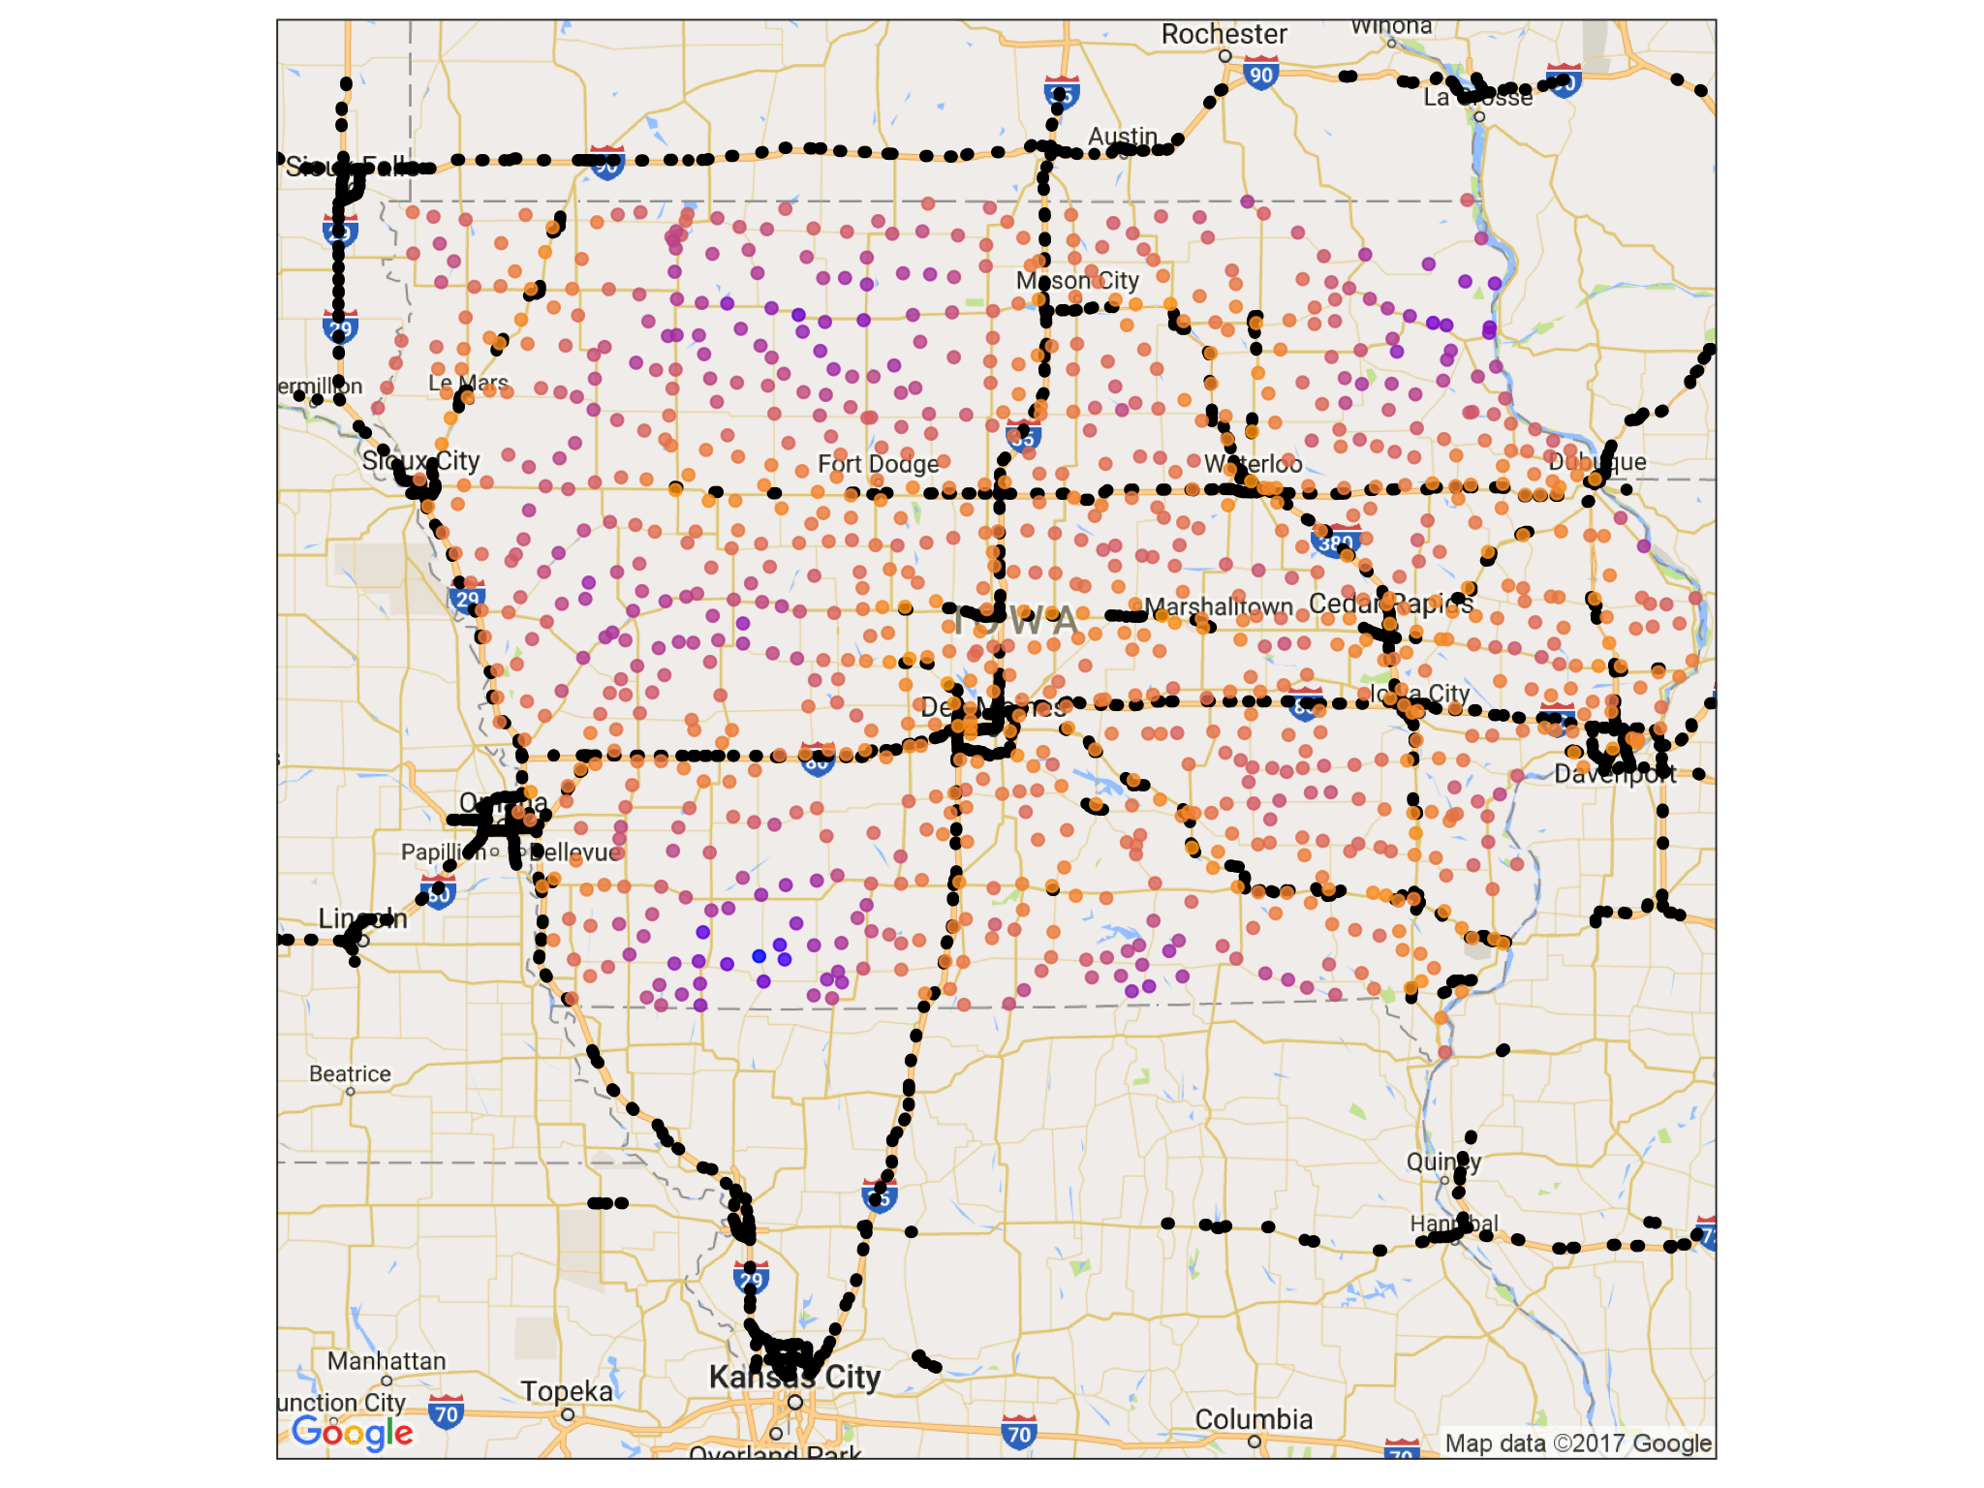
Iowa as a pilot study
Highway exits from OpenStreetMap (includes nearby exits outside of Iowa)
946 incorporated cities in Iowa, excluding Des Moines
Driving time to highway ranges from 2 to 83 min (median of 20 min)
NEED PLOT LEGEND

Slide 9
Text from Google place reviews
REDO PLOT
Fetch all reviews for establishments within a 5km radius of city centers
24,469 total reviews
Retain 546 cities with at least 5 reviews
Add example reviews

Slide 10
Demographic data
xxx
Add that we got demographic data, show demographic maps (and plan to add it into our analyses)

Slide 11
Motivation
Methods
Findings
Next Steps

Slide 12
Linguistic Diversity (within towns)
Type-token ratio
Ask what are better measures of this?

Slide 13
Linguistic Features
Review length
Capitalization
Emoji use
Punctuation
Sentiment

Slide 14
Linguistic Distinctiveness (between towns)
We have yet to do…

Slide 15
Motivation
Methods
Findings
Next Steps

Slide 16
Future Directions
Account for
Demographics
Content variability (e.g., only examine Subway ® or pharmacies)
Variability in # reviews
Different measures of linguistic diversity
Different measures of migration/movement
Inflow and outflow in cities (e.g., Craigslist ads)
Employee movement between organizations
Gentrification patterns

Slide 17
Appendix

Slide 18
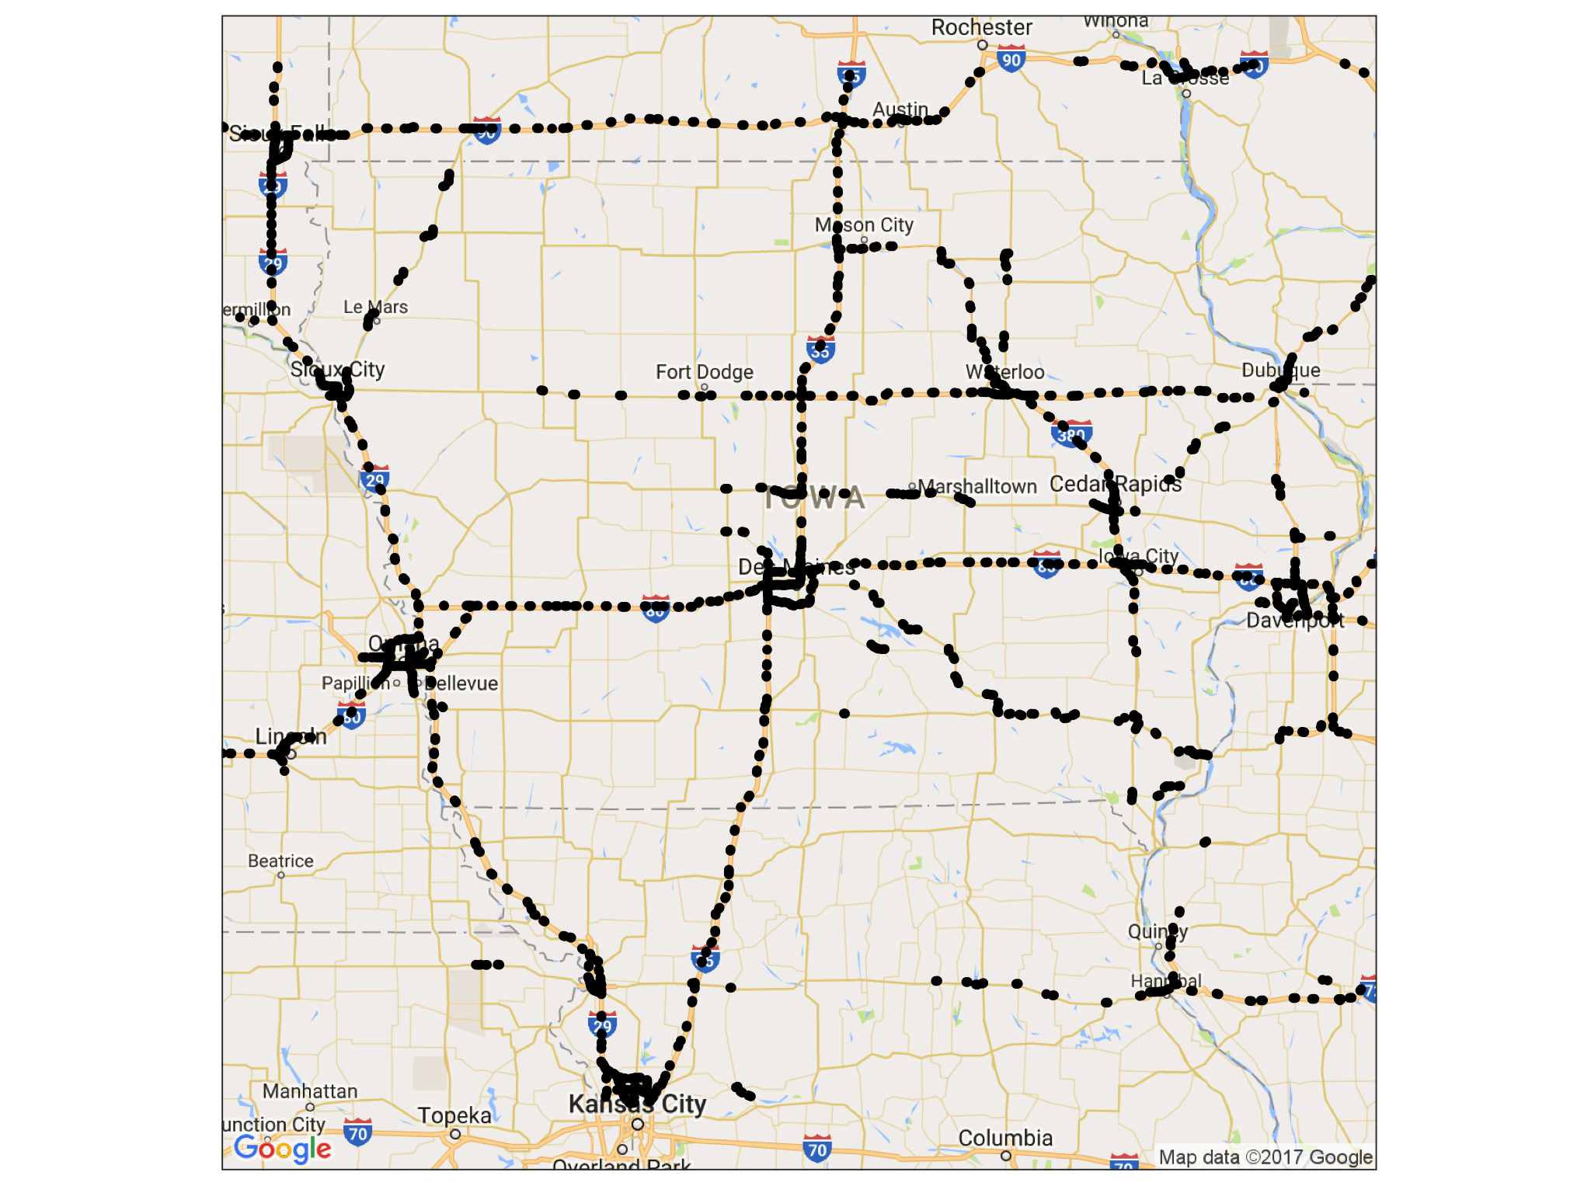
Highway Exits

Slide 19
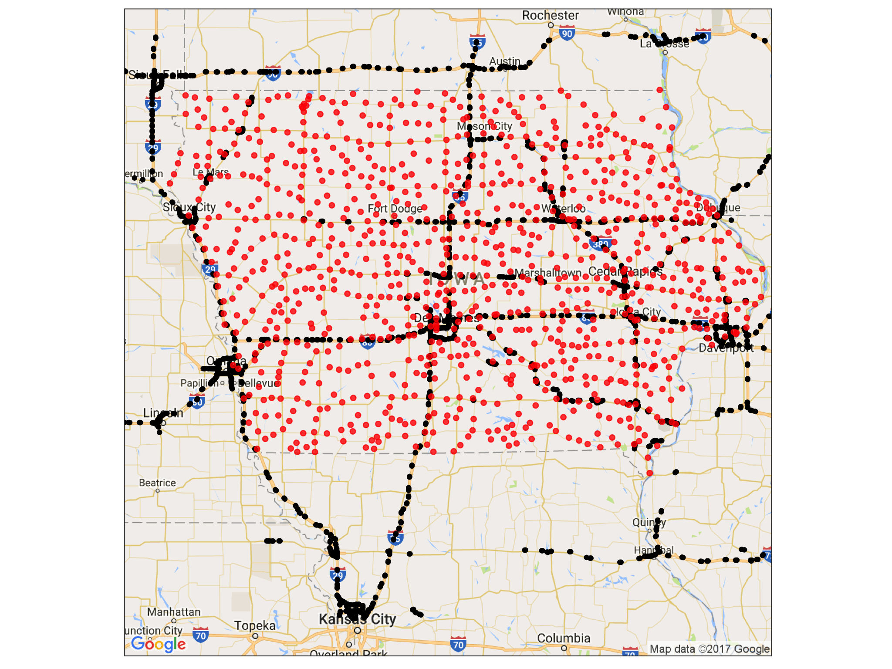
Towns in Iowa

